Slide 1
Angular 2
Angular 2 Fundamentals
Notes:
Add instructor notes here.

Slide 2
Angular 2 Introduction
Angular 2 is the next version of Google’s massively popular MV* framework.
Angular 2 is a framework to help us build client applications in HTML and either JavaScript or a language (like Dart or TypeScript) that compiles to JavaScript.
Angular 2 comes with almost everything required to build a complicated frontend web or mobile apps, from powerful templates to fast rendering, data management, HTTP services, form handling, and so much more.
Notes:
Add instructor notes here.

Slide 3
Why Angular
Angular makes HTML more expressive, It powers up HTML with features such as if conditions, for loops and local variables.
Angular has powerful data binding. We can easily display fields from our data model, track changes and process updates from the user.
Angular promotes modularity by design so that the applications become a set of building blocks making it easier to create and reuse contents.
Angular has built-in support for communication with a backend service this makes it easy for Web applications to integrate with the backend service to GET and POST data or execute server side business logic.
Notes:
Add instructor notes here.

Slide 4
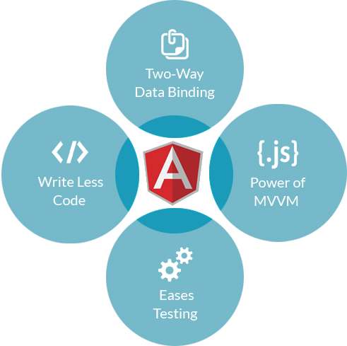
Why Angular
Notes:
Add instructor notes here.

Slide 5
Why Angular 2
Angular 2 was built for speed, It has faster initial loads faster change detection and improved rendering times.
Angular 2 is modern it takes advantage of features provided in the latest JavaScript standards such as classes, modules and decorators.
It leverages web component technologies for building reusable user interface widgets.
It supports both modern and legacy browsers like Chrome, Firefox and Internet Explorer back to IE 9.
It has a simplified API. It has fewer built-in directives to learn simple binding and a lower overall concept count.
It enhances productivity to improve day to day workflows
Notes:
Add instructor notes here.

Slide 6
Angular 2 Code Editors
Visual Studio
Brackets
Eclipse
Visual Studio Code
Webstrom
Sublime
Notepad++ (or) Editor ++
Notes:
Add instructor notes here.

Slide 7
Language Choice
ES5
ES6
TypeScript
Dart
Notes:
ECMAScript, or ES:
ES 3 is supported by older browsers.
ES 5 is the version currently supported by most modern browsers.
ES 6 specification was recently approved and renamed ES 2015(Most browsers don’t yet support ES 2015).
TypeScript:
TypeScript is the superset of JavaScript and must be transpiled.
TypeScript has great tooling.
Inline documentation.
Syntax checking.
Code navigation.
Advanced refactorings (The Angular team itself takes advantage of these benefits and uses TypeScript to build Angular 2).
Dart
Dart is a non-javascript based object to built Angular2
Add instructor notes here.

Slide 8
Angular 2 Dependencies
To run Angular 2, we depend on these four libraries:.
core-js
zone.js
reflect-metadata
SystemJS
Notes:
To include them, add the following inside your <head>
<script src="node_modules/core-js/client/shim.min.js"></script>
<script src="node_modules/zone.js/dist/zone.js"></script>
<script src="node_modules/reflect-metadata/Reflect.js"></script>
<script src="node_modules/systemjs/dist/system.src.js"></script>
Core-js
It provides shims so that legacy JavaScript engines behave as closely as possible to ECMAScript 6. It is not strictly needed for newer versions of Safari, Chrome, etc. but it is required for older versions of IE.
Zones
Zone.js is a library used by Angular, primarily for detecting changes to data
Reflect Metadata
Angular itself was written in Typescript, and Typescript provides annotations for adding metadata to code. The reflect-metadata package is a polyfill that lets us use this metadata.
SystemJS
SystemJS is a module loader. That is, it helps us create modules and resolve dependencies.
Add instructor notes here.

Slide 9
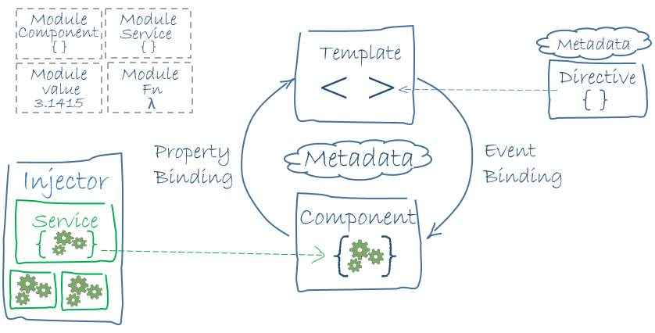
Building Blocks of an Angular 2
Application
Angular Frameworks
Router
Http
Compiler
Platform
Libraries
core & common
Rx
Reflect
Zone
System
shim
Notes:
Add instructor notes here.

Slide 10
Angular 2 Application
Angular 2 application is comprised of a set of components and some services that provide functionality across those components.
Angular
Application
Component
Component
=
+
…
Services
Notes:
An Angular 2 Application is nothing more than a tree of Components.
At the root of that tree, the top level Component is the application itself. And that’s what the browser will render when “booting” (a.k.a bootstrapping) the app.
Angular 2 does not have a bootstrap directive (ng-app). We always launch the app in code by explicitly calling a bootstrap function and passing it the name of the application's module.
One of the great things about Components is that they’re composable. This means that we can build up larger Components from smaller ones. The Application is simply a Component that renders other Components.
Because Components are structured in a parent/child tree, when each Component renders, it recursively renders its children Components.
Angular 2 standard module bootstrap is loaded from the angular2/platform/browser module. Using this module we have access to the bootstrap method, which we use right after the import statements to start our Angular 2 application by loading the App component via this method
Add instructor notes here.

Slide 11
Importing Modules
Module loader finds an external function or class using the import statement.
imports statement allows us to use exported members from external modules. External modules can be a third party library or our own modules or from angular itself.
If multiple members from the same module is needed, It can be listed in the import list separated by commas.
Angular is a collection of library modules, each library is itself a module made up of several related feature modules.
@angular/
core
@angular/
forms
@angular/
http
@angular/
router
}
Angular Modules
Notes:
Some modules are libraries of other modules. Angular itself ships as a collection of library modules.
angular2/core is the primary Angular library from which we get most of what we need.
For example, to import the Angular Component function from angular2/core
import {Component} from 'angular2/core';
import statement is part of ES 2015 and implemented in typescript . It is conceptually similar to the import statement in java or using statement in C#
import statement tells angular where to find the members that component needs from any external modules.
import statement requires the import keyword followed by the member name and module path, both are case sensitive.
The path to the module file must be enclosed in quotes, no need to specify the file extension.
Add instructor notes here.

Slide 12
Root Module
An Angular module class describes how the application parts fit together.
Every application has at least one Angular module, the root module that you bootstrap to launch the application.
The conventional name for the root module is AppModule .
import { NgModule } from '@angular/core';
import { BrowserModule } from '@angular/platform-browser';
import { AppComponent } from './app.component';
@NgModule({
imports: [ BrowserModule ],
declarations: [ AppComponent ],
bootstrap: [ AppComponent ]
})
export class AppModule { }
Notes:
In Angular 1, we achieved this through directives, controllers, and scope. In Angular 2, all those concepts are combined into Components
Component is comprised of a template which is the HTML for the user interface fragment to finding a view for the application.
Component is a view to find with the template and it’s associated code find with the class and additional information defined with Meta data
The internal structure of a component
Every component has two main internal parts:
An internal Html/CSS tree that encapsulates how the component view is built
A Controller class, which coordinates the interaction between the view and the input model
Add instructor notes here.

Slide 13
Introduction to Angular Components
Components are the main way to build and specify elements and logic on the page.
Component is comprised of a template and class.
Template provides HTML(View) for the user interface.
Class provides the code associated with the view.
Class contains the properties or data elements to be used in the view and methods to perform actions for the view.
Component also has metadata, which provides additional information about the component
Meta data that identifies the class as an angular component.
Notes:
In Angular 1, we achieved this through directives, controllers, and scope. In Angular 2, all those concepts are combined into Components
Component is comprised of a template which is the HTML for the user interface fragment to finding a view for the application.
Component is a view to find with the template and it’s associated code find with the class and additional information defined with Meta data
The internal structure of a component
Every component has two main internal parts:
An internal Html/CSS tree that encapsulates how the component view is built
A Controller class, which coordinates the interaction between the view and the input model
Add instructor notes here.

Slide 14
Angular 2 Component
A component contains application logic that controls a region of the user interface (view)
Component
Template
Class
=
+
Metadata
+
Properties
Methods
Notes:
Angular apps are modular. In general we assemble our application from many modules.
A typical module is a cohesive block of code dedicated to a single purpose. A module exports something of value in that code, typically one thing such as a class.
An angular component includes a template(View Layout) which lays out the user interface fragment defining a view for the application. It is created with HTML and defines what is rendered on the page.
Binding and Directives in the HTML powers up the view
Class contains the code associated with the view. Classes are created with typescript which contains the properties or data elements available for view. For instance to display a title in the view we need define a class property for the title in the class.
Class also contains methods which are the functions for the logic needed by the view. For Instance to show and hide an image we need to write the logic in a class method.
A component also has Meta data which provides additional information about the component. To angular this Meta data defines the class as an angular component.
Meta data is defined with a decorator, a decorator is a function that adds Meta data to a class, its members or its method arguments.
Add instructor notes here.

Slide 15
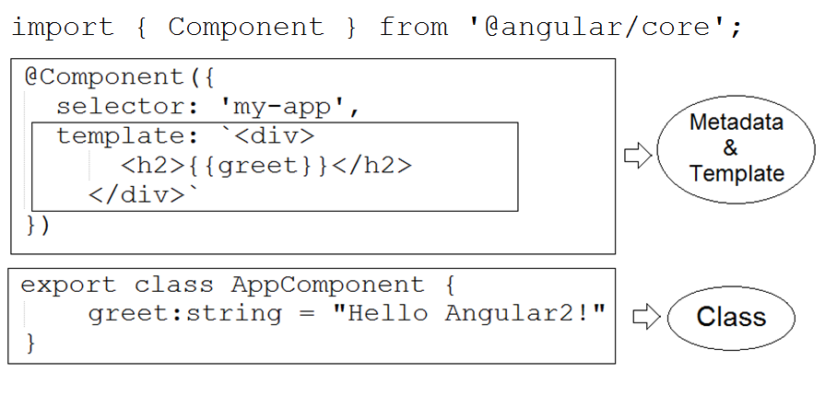
Angular Component Using TypeScript
Notes:
Create a class for the component with code to support the view.
Use a decorator to define the component Meta data which includes the HTML for the components template
Import the required modules from any third party library or from own modules or from angular itself
Give a clear name for the component because it is not only the name of the class but the name of the component as well
use Pascal casing and append component to the end of the class name to make it clear that it is a component class
Include the export keyword on the class signature
export keyword makes the class accessible to be imported by other parts of the application
Use camel case for the properties and methods in the class.
To leverage typescript strong typing be sure to set the appropriate data type for each property and set a default value appropriately
Add instructor notes here.

Slide 16

Component Class
Class is a construct that allows to create a type with properties and methods.
As per convention, name the component class with a feature name then append the word component as the suffix.
Also by convention root component for an application is called AppComponent.
Class name is used as the component name when the component is referenced in code.
export keyword exports the class; thereby making it available for use by other components of the application.
Notes:
export keyword makes the file as a module and will be loaded by a module loader no need to add a script tag for it.
A property(data element) associated with the class must be a noun describing the data element and it should be in camel case.
Methods are normally defined within the class body after all of the properties. Method names are often verbs that describe the action the method performs and it should be in camel case.
Meta data for a component can be set using component decorator
A class is not a component unless it has a component decorator be sure to prefix the decorator with an '@'
since a decorator is a function add parenthesis pass in the appropriate object properties. Use the selector property to define the name of the component when used as a directive in HTML. selector property is not needed if the component is not used in any HTML
Use the template property in the component Meta data to define the view's HTML. Since the HTML in a string literal Intellisense or syntax checking wont be available, so take care to define correct HTML syntax
Add instructor notes here.

Slide 17
Component Metadata
A class becomes an angular component, when component meta data is given. Metadata tells Angular how to process a class.
Angular needs metadata to understand, how to instantiate the component, construct the view and interact with the component.
Components meta data is defined with the angular Component function. In Typescript this function is attached to the class as a decorator.
@Component decorator is used to identify the class as a component. It takes object as a parameter which has many properties like selector, template etc
selector defines the components directive name which is used to reference the component in HTML.
Whenever this directive is used in the HTML angular renders this components template
Notes:
A decorator is a function that adds Meta data to a class its members or its methods arguments. It is a java script language feature that is implemented in typescript and proposed for ES 2016(the next version of JavaScript)
The scope of the decorator is limited to the feature that it decorates. A decorator is always prefixed with an ‘@’ sign.
Angular has several built-in decorators to provide additional information to angular. We can also build our own decorators.
selector defines the components directive name which is used to reference the component in HTML, whenever this directive is used in the HTML angular renders this components template
Add instructor notes here.

Slide 18
Angular 2 Metadata
The main objective @Component decorators is to add meta-data to the application which tells Angular 2 how to process a class.
When building Angular components we can configure the following options:
selector : defines the name of the HTML tag where the component resides
providers: Used to pass services for the component
styles : Used to style a specific component.
template : This is the portion of our component that holds template. It is an integral part of the component as it allows to tie logic from component directly to a view. It can be either inline, or external template using templateUrl to link to an external template.
Notes:
Component Metadata
Names:
selector? : string
exportAs? : string
Binding:
inputs? : string[]
outputs? : string[]
host? : {[key: string]: string}
changeDetection?: ChangeDetectionStrategy
View:
templateUrl? : string
template? : string
styleUrls? : string[]
styles? : string[]
encapsulation?: ViewEncapsulation
Injector:
providers? : any[]
viewProviders? : any[]
directives? : Array<Type | any[]>
pipes? : Array<Type | any[]>
queries? : {[key: string]: any}
Add instructor notes here.
Component Metadata
Directive Metadata

Slide 19
Demo
Creating-AppComponent
Notes:
Add the notes here.
Add instructor notes here.

Slide 20
Template
Template are mostly HTML which is used to tell Angular how to render the component.
Template for a component can be created using
Inline template (Embedded template string)
Linked template (Template provided in external html file)
Inline template can be defined with template property using a single or double quotes or with a multiline string by enclosing the HTML in ES 2015 back ticks.
Back ticks allows to compose multiline string which makes the HTML more readable.
Linked template is used to define the HTML in its own file by providing the URL of the HTML file using templateUrl property.
Path provided in templateUrl property is relative to the application root which is usually the location of the index.html
Notes:
There are advantages and disadvantages in using Inline template
Advantages
Template is directly defined within the component keeping view and the code for that view in a single file.
Easy to match up data bindings with the class properties
Disadvantages
Most development tools doesn't provide intellisense, automatic formatting and syntax checking.
It becomes challenge to maintain when more HTML is defined.
Add instructor notes here.

Slide 21
Demo
InlineTemplate
LinkedTemplate
Notes:
Add the notes here.
Add instructor notes here.

Slide 22
Component Styles
Angular 2 applications are styled with regular CSS. i.e. CSS stylesheets, selectors, rules, and media queries can be directly applied.
Angular 2 has the ability to encapsulate component styles with components enables more modular design than regular stylesheets.
In Angular 2 component, CSS styles can be defined like HTML template in several ways
As inline style in the template HTML
Template Link Tags
By setting styles or styleUrls metadata
Notes:
The URL is relative to the application root which is usually the location of the index.html web page that hosts the application. The style file URL is not relative to the component file.
Special selectors
Component styles have a few special selectors from the world of shadow DOM style scoping:
:host : pseudo-class selector to target styles in the element that hosts the component
:host-context() : Looks for a CSS class in any ancestor of the component host element, all the way up to the document root. It's useful when combined with another selector.
/deep/ : selector to force a style down through the child component tree into all the child component views. The /deep/ selector works to any depth of nested components, and it applies both to the view children and the content children of the component.
Add instructor notes here.

Slide 23
Demo
ComponentStyles
Notes:
Add the notes here.
Add instructor notes here.

Slide 24
Summary
Every application must bootstrap at least one component, the root application component.
As a best practice, We need to launch the application by bootstrapping the AppModule in the main.ts file.
The bootstrap array should be used only in root application module i.e. AppModule
NgModule is a way to organize the dependencies for compiler and dependency injection.
NgModule can import other modules as dependencies
Angular uses a library called Zone.js to automatically detect the things changed and trigger the change detection mechanism
Notes:
Add instructor notes here.

Slide 25
Summary
Every component must be declared in some NgModule and a component can belong to one and only one NgModule
exports key is nothing but the list of public components for NgModule.
Angular2 Application is a tree of components and the top level component is nothing but the application.
Components are Composable.
Template for a component can be created using InlineTemplate and LinkedTemplate using template and templateUrl respectively.
styles and styleUrls keys are used in components to work with styles in Angular 2
Notes:
Add instructor notes here.

